Slide 1
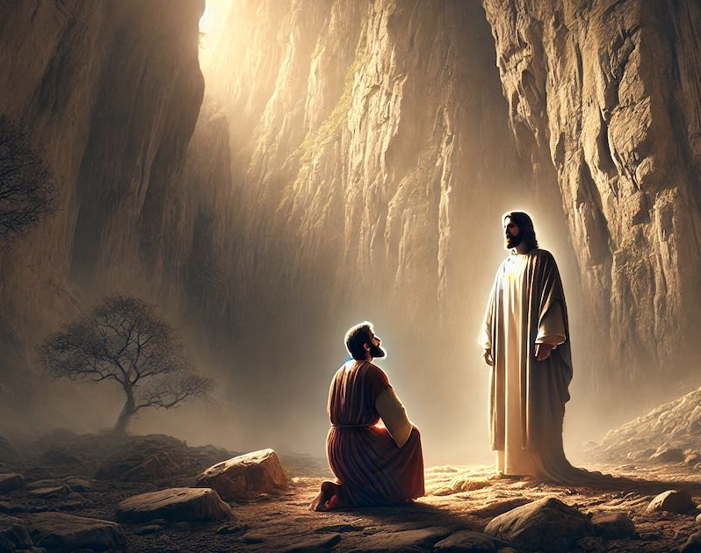
Peter
Journey to the Cross,
Path to Life
The Confession that Changes Everything

Slide 2
Mark 8 vs 27
And Jesus went on with His disciples to the village of Caesarea Philippi.
“Who do people say that I am?”
“And who do you say I am?”

Slide 3
Mark 8 vs 29
But who do you say I am?
And peter answered him, “You are the Christ.”
“With those three words in Greek, “Sy ei ho Christos,” everything changed.

Slide 4
"You are the Anointed One.
You are the Chosen One.
You are the King.
You are the One we have been waiting for our entire lives, for thousands of years."

Slide 5
“I am the resurrection and the life.
Whoever believes in me, though he die, yet shall he live.”

Slide 6
Psalm 22 vs 1
My God, my God, why have you forsaken me?

Slide 7
Psalm 22 vs 22
I will tell of your name to my brothers and sisters; in the midst of the congregation, I will praise you.

Slide 8
You who fear the LORD, praise him! All you offspring of Jacob, glorify him, and stand in awe of him, all you offspring of Israel!

Slide 9
Three Challenges for our Journey to the cross this week.
Challenge 1:
The Challenge of Location (Go to Caesarea Philippi).
Challenge:
This week, identify your "Caesarea Philippi."
Go there this week, and in your heart, confess “Jesus, You are the Messiah."

Slide 10
Three Challenges for our Journey to the cross this week.
Challenge 2:
The Challenge of Revelation (Get on Your Knees).
Challenge:
This week, pray for a fresh revelation of who Jesus Christ is.
Ask God to show you, personally, that Jesus is the Christ. Do pray for someone you know who doesn’t yet believe. Pray that the Father would reveal the truth to him/her, because only He can.

Slide 11
Three Challenges for our Journey to the cross this week.
Challenge 3:
The Challenge of the Cross (Embrace the Path).
Challenge:
This week identify one area of your life where you are resisting the cross.
Write it down, Name it, And take up that cross.

